Slide 1


Helping people and places tell the story of their learning.
Badging Standard 101

Slide 2



The Cities of Learning Badging Standard is a scaffold to support coherent and aligned place-based learning.
It is based on the OECD’s Future of Education and Skills 2030 learning compass. The metaphor of a learning compass was adopted to emphasise the need for learners to learn to navigate along their own learning journey.
The badging standard ensures the Cities of Learning approach has at its heart a commitment to rigorous, future-focused and holistic learning.
Rigorous, because learning needs structure.
Future-focused, because we know the world is changing and learning & skills systems must change with it.
Holistic, because in today’s world learners need a combination of knowledge, skills, attitudes & values to succeed wherever they’re heading.

Slide 3


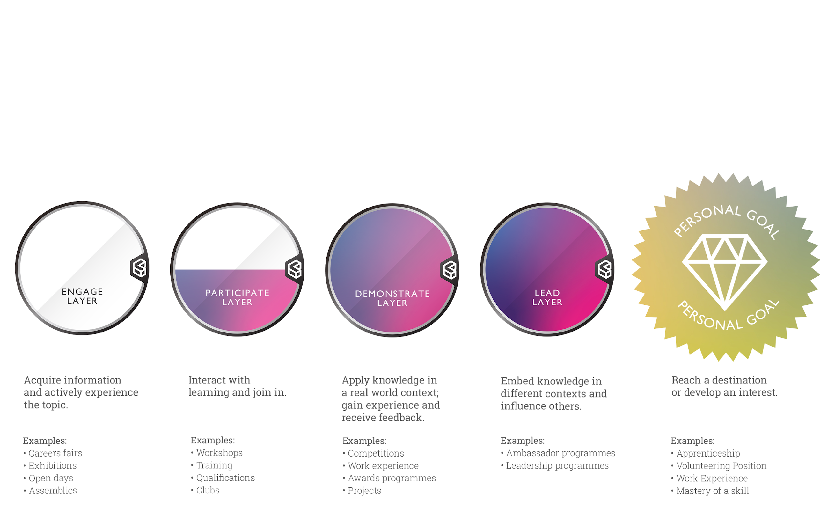
CITIES OF LEARNING BADGING STANDARD
The Cities of Learning Badging Standard provides a structure to communicate learning in a consistent way, making it easier to understand what people are doing, how it helps and where it could lead.

Slide 4

CITIES OF LEARNING BADGING STANDARD
The badging standard breaks down in each layer the knowledge, skills, attitudes and values being developed, which are then recognised and communicated through an open badge.
KNOWLEDGE
Acquire information
Interact with learning
Apply knowledge within real world context
Embed knowledge in different contexts
SKILLS
Actively experience
Join in
Gain experience and receive feedback to develop
Influence others
ATTITUDES & VALUES
Understand what’s expected
Meet expectations
Show consistency
Take ownership and inspire

Slide 5
Helping people and places tell the story of their learning.
CITIES OF LEARNING BADGING STANDARD
Each Layer represents a different type of learning experience.
Information is given to learners to engage them with a topic and encourage them to undertake further learning opportunities in this area. | Learning is interactive and undertaken with other people to deepen knowledge of a subject. Activities have specific learning outcomes to help learners progress. | Learning is contextualised in a real world setting and learners are given the opportunity to present their work and receive feedback to help them grow. | Learners are given the opportunity to embed their knowledge in different contexts. Through their work they can show how they have inspired and influence others.
Examples: Careers fairs Exhibitions Open days Assemblies | Examples: Workshops Training Qualifications Clubs | Examples: Competitions Work experience Awards programmes Projects | Examples: Ambassador programmes Leadership programmes.

Slide 6




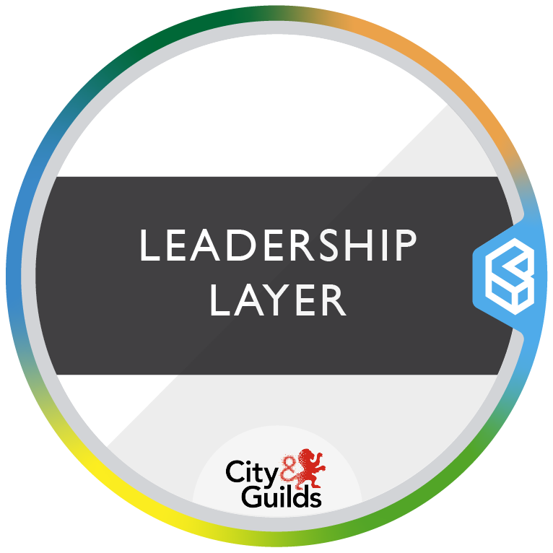
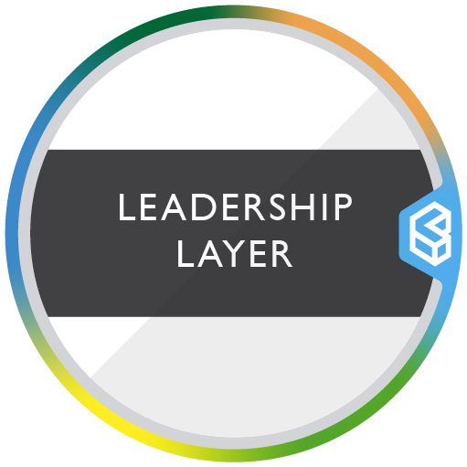

HELPING PEOPLE & PLACES TELL THE STORY OF THEIR LEARNING
How the badging standard works for people
WHAT CAN I DO?
Get involved in local activities
Discover opportunities to study or work in different industries
Feel better and stay well
HOW CAN I DO IT?
Find out what interests you
Learn about something
Show other people what you can do
Inspire and influence others
WHERE WILL IT TAKE ME?
Enroll for further study
Get a job
Contribute to your local area
Work for yourself

Slide 7
HELPING PEOPLE & PLACES TELL THE STORY OF THEIR LEARNING
How the badging standard works for places
WHAT CAN I DO?
Become a Cities of Learning provider
Use the badging standard to categorise your activities
Design badges for people completing activities
HOW CAN I DO IT?
Ask people to share their learning story
Issue badges when people complete activities
Promote ongoing learning in your city
WHERE CAN IT LEAD?
Help people access further study
Support people to get their first job
Increase contributions to the local area
Support people to become self-employed

Slide 8
Cities of Learning’s Digital Open Badges are micro-credentials that recognise all forms of learning wherever it happens. They allow learners to communicate what they’ve learned to others, and Cities and places to connect and amplify their learning offer.
Every badge a learner earns is aligned to the Badging Standard. It captures the knowledge, skills, attitudes and values developed in completing the learning activity the badge represents.
By having the Badging Standard embedded in all badges…
...learners can understand and articulate their learning in a rigorous, future-focused and holistic way.
...learning providers can recognise what learners will develop through their provision.
...destination providers can be confident that learners who have earned a particular combination of badges will have the knowledge, skills, values and attitudes needed to succeed.

Slide 9









Digital open badges are tools for learners to communicate learning. They capture the knowledge, skills, attitudes & values in meta-data and are shareable across the web and a place, using open standards.
Visual
Open
Universal
Safe & secure
Data-rich
Evidence based
Shareable
Verifiable
Trackable
Portable
Connected
Issuer
Knowledge, skills, attitudes & values
Endorser
Allowing everyone to recognise learning with greater trust

Slide 10




Helping people and places tell the story of their learning.
How Open Badges work:
An individual meets requirements to earn an open badge
Organisation issues the digital badge
The individual accepts and shares their open badge
Learners build a portfolio of open badges

Slide 11








Examples:

Slide 12
Learners combine Cities of Learning’s badges to pursue their own learning pathways that are either interest-driven or progress them towards a specific destination.
Every pathway a learner travels along is aligned to the Badging Standard. It tracks the knowledge, skills, attitudes and values developed along their learning journey, building layers of learning upon one another.
By having the Badging Standard embedded in all pathways...
…learners can understand and articulate their progress in a rigorous, future-focused and holistic way.
…learning providers can connect and align their provision more coherently, particularly towards specific destinations.
…destination providers can signpost the right combinations of knowledge, skills, attitudes and values needed for learners to progress towards a specific destination.

Slide 13
A Cities of Learning pathway comes in three different forms:
Interest-driven pathways - learners create their own pathways by exploring learning experiences they find interesting.
Destination-driven pathways (predetermined) - learning providers and destination providers design a combination of learning experiences that unlock a specific opportunity.
Destination-driven pathways (rules-based engine) - the Cities of Learning App suggests a variety of learning experiences that learners can select from to progress them towards a chosen destination.

Slide 14
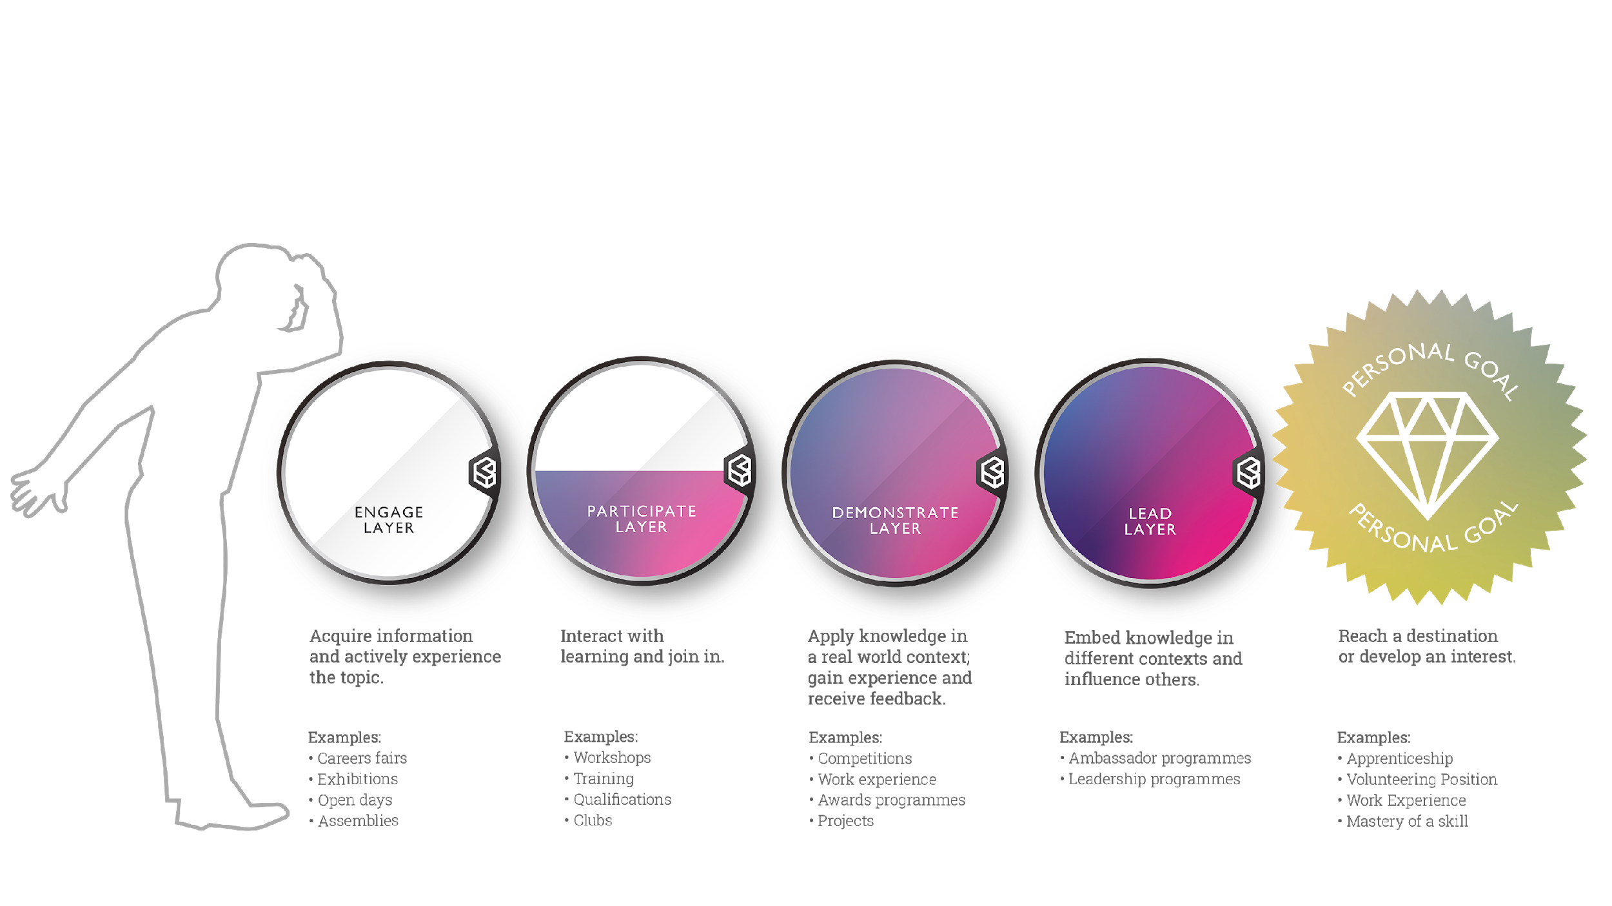

Slide 15







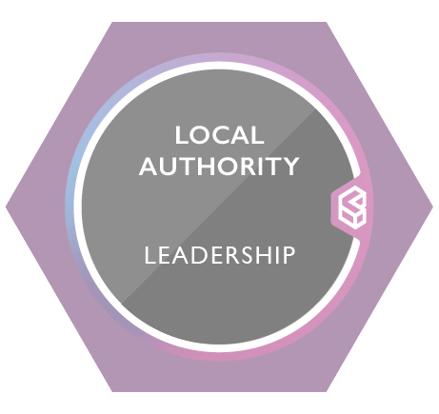
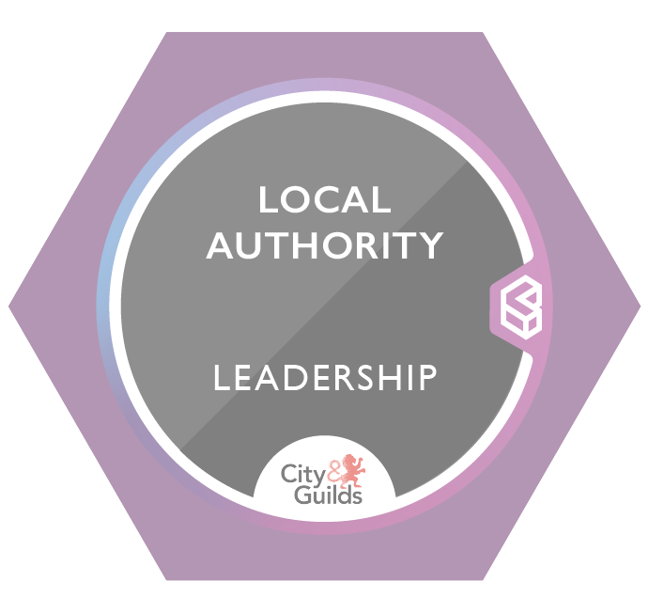










INTEREST - DRIVEN PATHWAY Learner creates their own pathway by exploring learning experiences they find interesting A rules based engine suggests activities which fill in knowledge, skills, attitudes and values gaps
Knowledge
Skills
Attitudes & Values
Formal Informal
KSA Tags
KSA Tags
KSA Tags
KSA Tags
Formal & informal local learning activities based on learner’s interests:
Coding
Arts
Destinations:
- Education
- Enterprise - Employment
- Civic Engagement
Technology
Creativity

Slide 16
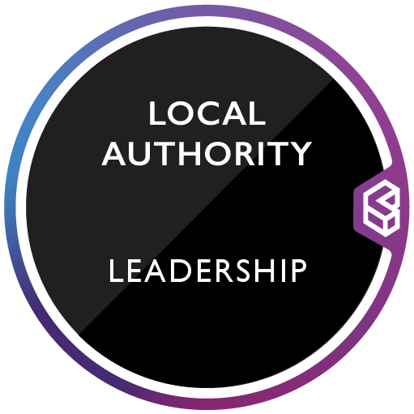
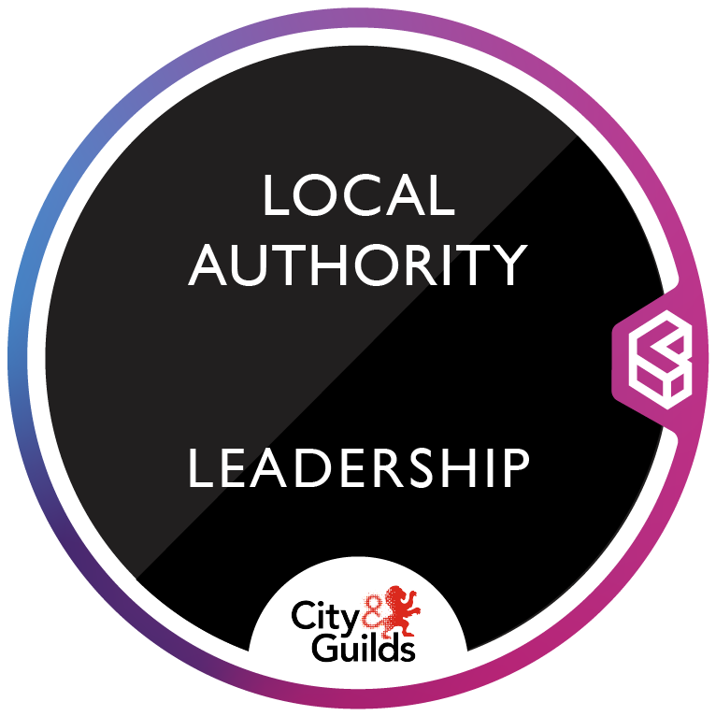
DESTINATION - DRIVEN PATHWAY (Pre-determined) Learning providers and destination providers design a combination of learning experiences that unlock a specific opportunity
Knowledge
Skills
Attitudes & Values
Formal Informal
KSA Tags
KSA Tags
KSA Tags
KSA Tags
Pre-determined formal & informal local learning activities for learners to engage with, in pursuit of a specific opportunity:
Destinations:
- Education
- Enterprise - Employment
- Civic Engagement

Slide 17




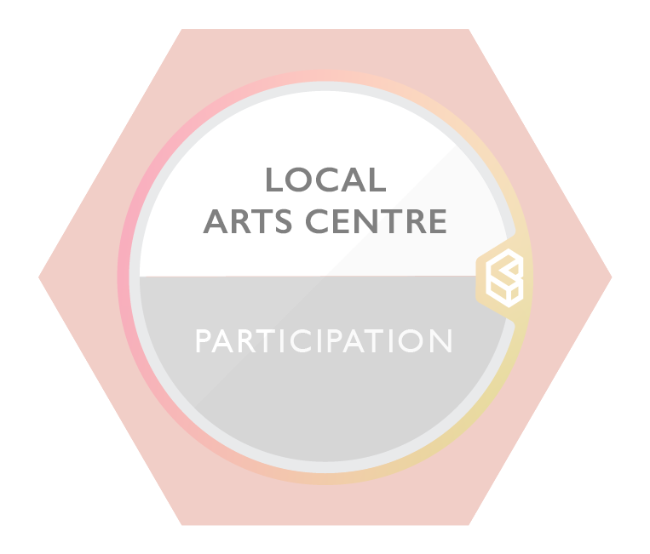
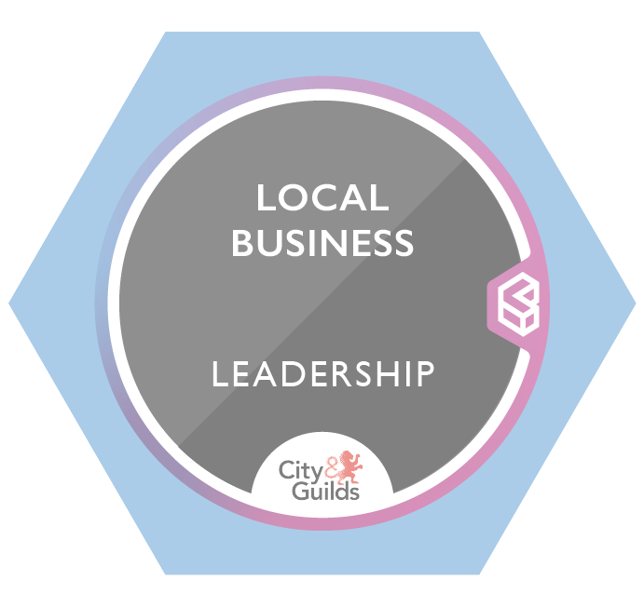
DESTINATION - DRIVEN PATHWAY (Rules-based engine)
The Cities of Learning App suggests a variety of learning experiences that learners can select from to progress them towards a chosen destination
Knowledge
Skills
Attitudes & Values
Formal Informal
KSA Tags
KSA Tags
KSA Tags
KSA Tags
A variety of formal & informal local learning activities that learners can choose to engage with:
Destinations:
- Education
- Enterprise - Employment
- Civic Engagement

Slide 18


Meet Sam.
Sam left school a few years ago. She’s had a few jobs since then but has struggled to find opportunities that she’s really passionate about.
She also lacks confidence in her own abilities and is unsure whether she can unlock the opportunities that she’s truly motivated by.
Sam’s parents previously encouraged her to explore further education opportunities but she ended up overwhelmed and confused by all the different options out there.
*Sam is a fictional character and her story is an example of what a Cities of Learning journey might look like.

Slide 19





Sam is looking to explore some new learning experiences in her city. Her local careers guidance officer introduces her to something called Cities of Learning. There’s even an App! It asks Sam whether to go on an interest-driven learning journey.
BBC North upload their internship to the Cities of Learning platform. They tag the knowledge, skills, attitudes and values they want to see in candidates.
Sam has always wanted to work in film,
So searches the App for opportunities and finds an internship at BBC North. It has a set of tags that outline the knowledge, skills, attitudes and values they are looking for in an intern. She selects the internship as her destination.

Slide 20





ENGAGEMENT LAYER
The Cities of Learning App suggests some local events that Sam might engage with. She attends three events over the course of three weeks, exploring new knowledge about the film industry and building skills in how to network, all the while demonstrating a curiosity to learn.
Learning Providers work with their City Anchor Institution to badge their provision and upload them to the Cities of Learning platform. They tag the knowledge, skills, attitudes and values learners will develop.
Sam receives an email from each of the hosts of the events she attended, awarding her a digital badge. She adds it to her Credly account, and shares it on her LinkedIn and Twitter pages.
She wants to find more learning opportunities, so she opens the App and finds it suggesting a new set of exciting experiences that help her towards her destination.
Digital badges:

Slide 21





PARTICIPATION LAYER
Sam decides to participate in a week-long script-writing course. By the end, she has learned how scripts are developed and had honed her own creative writing skills. Importantly, she has developed a sense of the importance of diversity, having learned that women are underrepresented and underpaid in the industry.
Sam earns herself another digital badge that recognises the knowledge, skills, attitudes and values she developed while completing the course.
But just as importantly, she has built a strong relationship with the course leader, Marina, who offered to mentor her over the next 6 months. They sit down together to explore further learning opportunities suggested to Sam on the Cities of Learning App.
Digital badges:

Slide 22



DEMONSTRATION LAYER
Sam decides to enrol in a part-time Media Studies course at her local FE college. Because of the Cities of Learning App, she knows it will help her along her learning journey towards the internship at BBC North. She’s also confident this is the right step for her because Marina knows the course and says she’ll have the opportunity to demonstrate what she knows and can do by the end of it.
Sam completes her course, finishing with a project that pairs her with an industry partner and requires her to apply what she’s learned to a real-world problem they face, and receive feedback from industry experts.
For her hard work she earns a digital badge, this time with external validation.
An external validator endorses a selection of badges through the City Anchor Institution depending on local demands.
Digital badges:

Slide 23



LEADERSHIP LAYER
Sam feels increasingly confident that she would make a great BBC North intern. She scrolls through the final set of suggestions on the Cities of Learning App, to look at what else she can do to guarantee an interview.
She spots an opportunity to work with her Local Authority to lead a project about raising awareness of young people to be ‘critical consumers’ of information.
An external validator endorses a selection of badges through the City Anchor Institution depending on local demands.
Sam develops her ability to embed her knowledge in different contexts, take ownership of a project and influence and inspire others to act.
An externally validated digital badge captures this and allows her to communicate these knowledge, skills, attitudes and values to the wider world, including BBC North.
Digital badges:

Slide 24

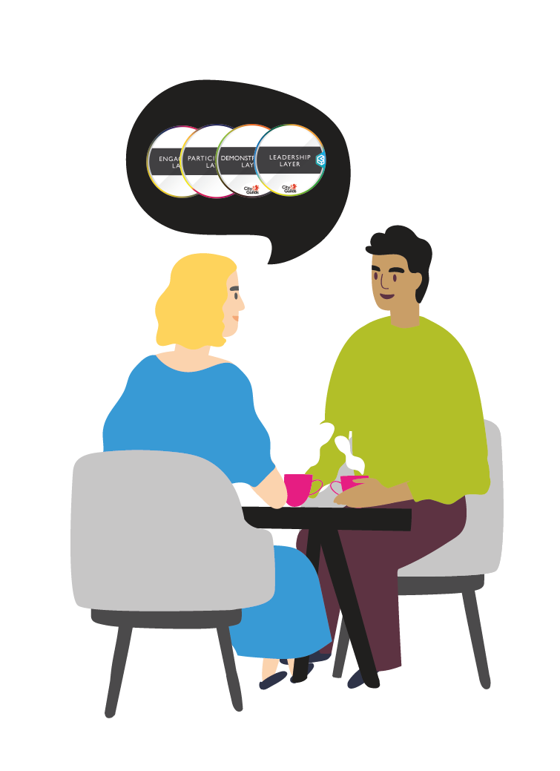



Sam can now communicate the necessary knowledge, skills, attitudes and values needed to unlock an initial interview with BBC North for their internship. She works with Marina to prep for it, reflecting on her journey to now.
At the interview, Sam uses her digital badges to tell her learning story, and talk about the knowledge, skills, attitudes and values she has developed.
The day after the interview, she meets up with other Cities of Learning Ambassadors who have travelled their own learning journey.
Sam gets a call from Clive at BBC North - she got the internship!
Digital badges:

